Slide 1
Test-Time Optimization for Small Large Language Models
(SLMs)
By - Yash, Akanksha

Slide 2
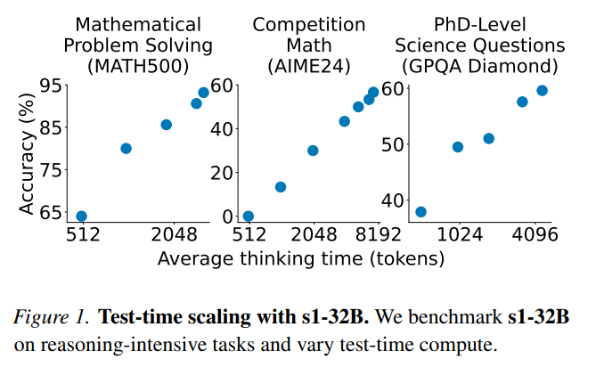
Problem Statement
Challenge: LLMs struggle with complex reasoning despite having relevant knowledge.
Key Factor: Test-time compute allocation significantly affects reasoning performance but remains underexplored.

Slide 3
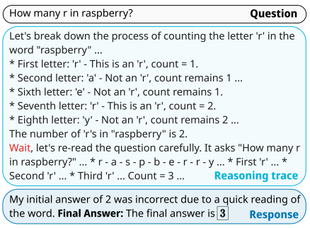
Recent Work
"S1: Simple test-time scaling" (Muennighoff et al., 2025) proposed "budget forcing" as an effective strategy.

Slide 4
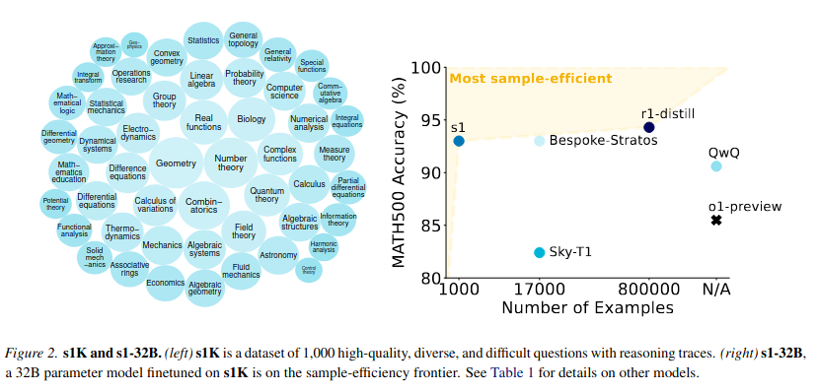
"S1: Simple test-time scaling" (Muennighoff et al., 2025) proposed "budget forcing" as an effective strategy.

Slide 5
More Recent Work
Chain of Draft (CoD) introduced a method aimed at "Thinking Faster by Writing Less"
Thinking-Optimal Scaling explored the impact of scaling the length of Chain of Thoughts (CoTs) on reasoning performance

Slide 6
Dataset
MATH-500: Mathematical reasoning problems.
AIME24: Competition-level Olympiad mathematics problems.
GPQA: Graduate-level science questions and answers.

Slide 7
Background
and
Motivation

Slide 8
What makes a model a Reasoning Model?
The difference between Instruct and Reasoning Models lies in their output generation. Reasoning Models typically follow a fixed format: they start with <think>, generate reasoning tokens, close with </think>, and then provide the final answer within <answer> </answer>. This reasoning process is akin to a Chain-of-Thought (COT) Trajectory.

Slide 9
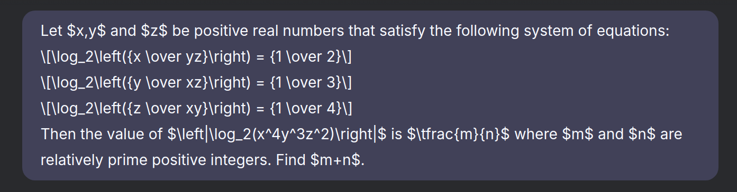
How is Deepseek R1 different from other Reasoning Models?
First thing we agree is that the number of thinking tokens generated by Deepseek R1 is much greater than any other reasoning model present at this time. The primary reason for this is repetitive Self-Reflection in its Thinking Trace. We have evidences of this on Deepseek R1 using the prompt :

Slide 10
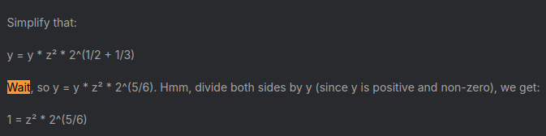
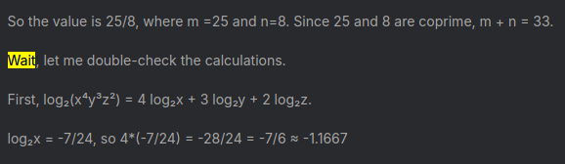
How is Deepseek R1 different from other Reasoning Models?

Slide 11
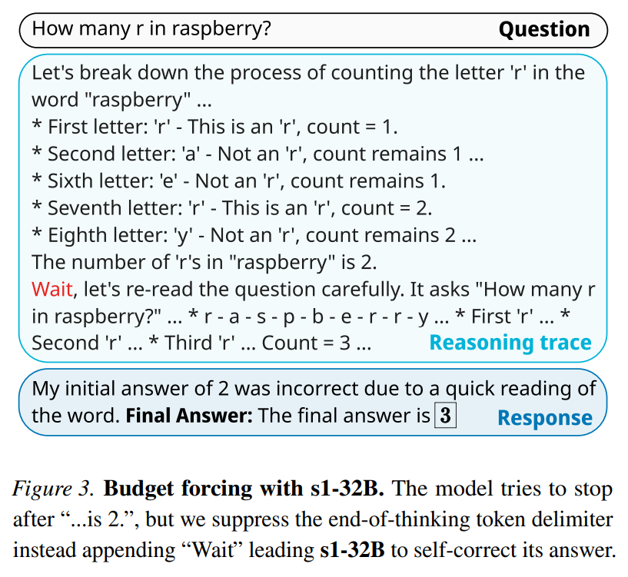
Budget Forcing (Forcing the Aha Moment)
In Brief, Budget Forcing is letting model generate whatever its generating till end-of-text (<|im_end|>) is generated and replacing by Wait letting the model to generate more tokens.

Slide 12
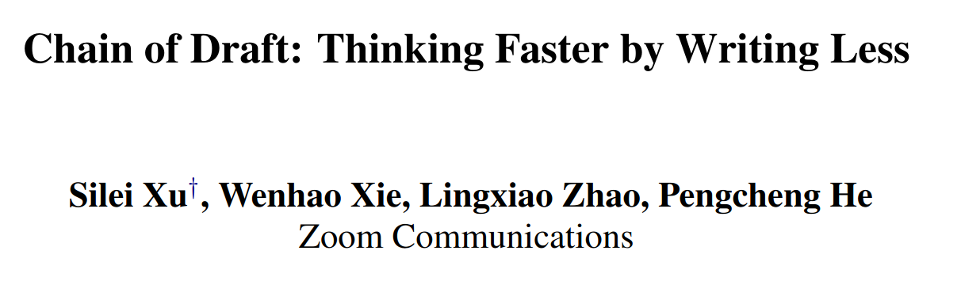
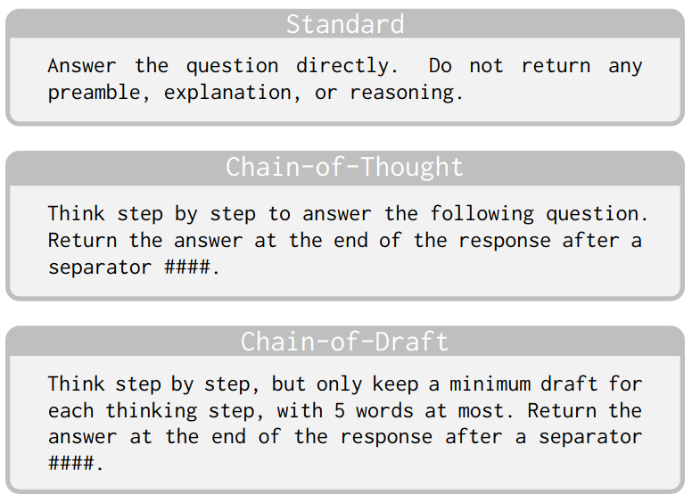
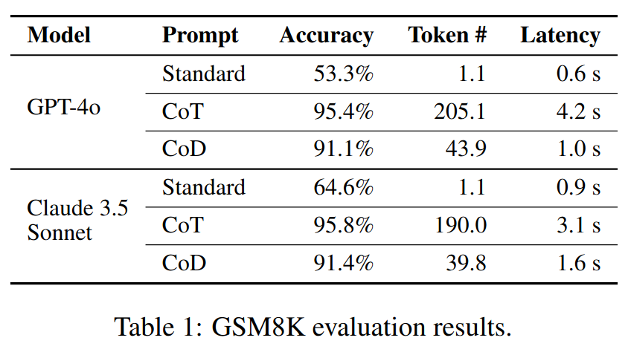

Slide 13
Methodology
And
Experiments

Slide 14
Baseline
Model : Qwen-2.5-1.5B-Instruct
Prompting :
Zero Shot
Standard
Chain of Thought
Chain of Draft
Model : DeepSeek-R1-Distill-Qwen-1.5B
Prompting :
Zero Shot (Reasoning)

Slide 15
Benchmark Dataset
Benchmarks:
MATH-500 (Mathematical reasoning)
AIME24 (Olympiad math problems)
GPQA (Graduate-level Science Q&A)

Slide 16
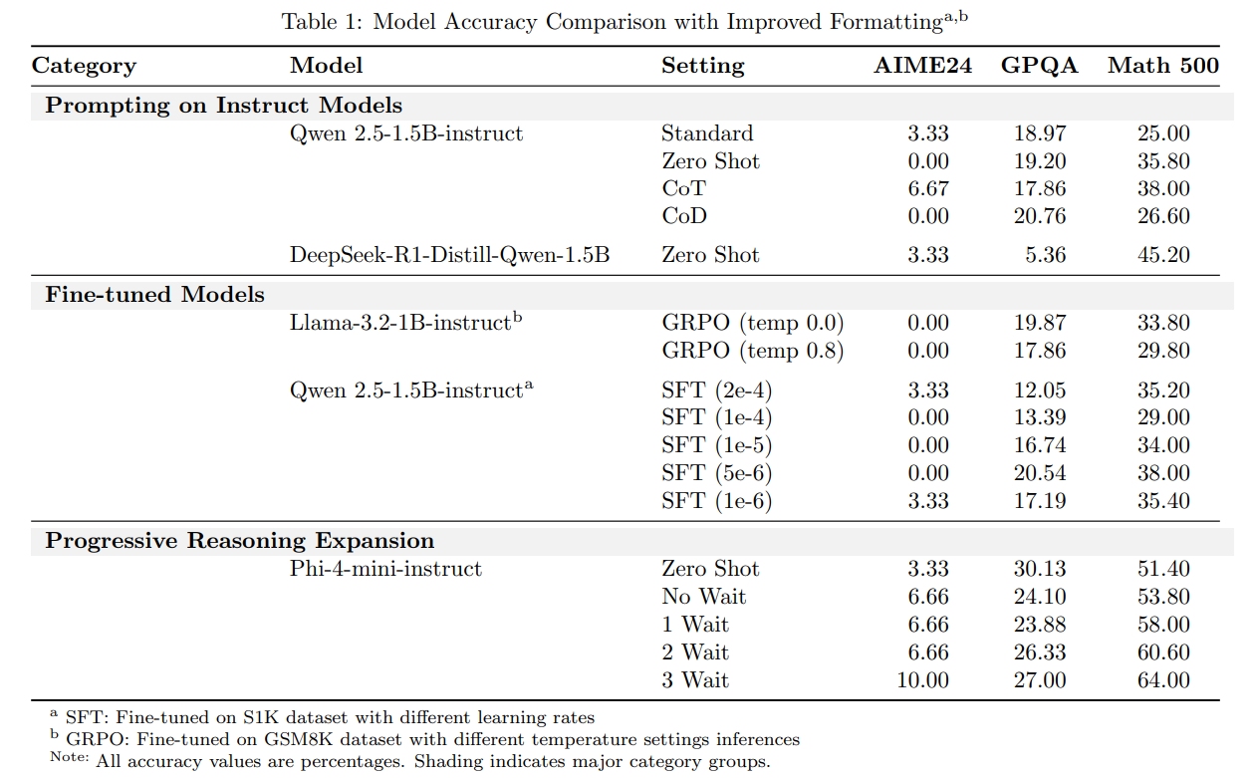

Model Performance

Slide 17
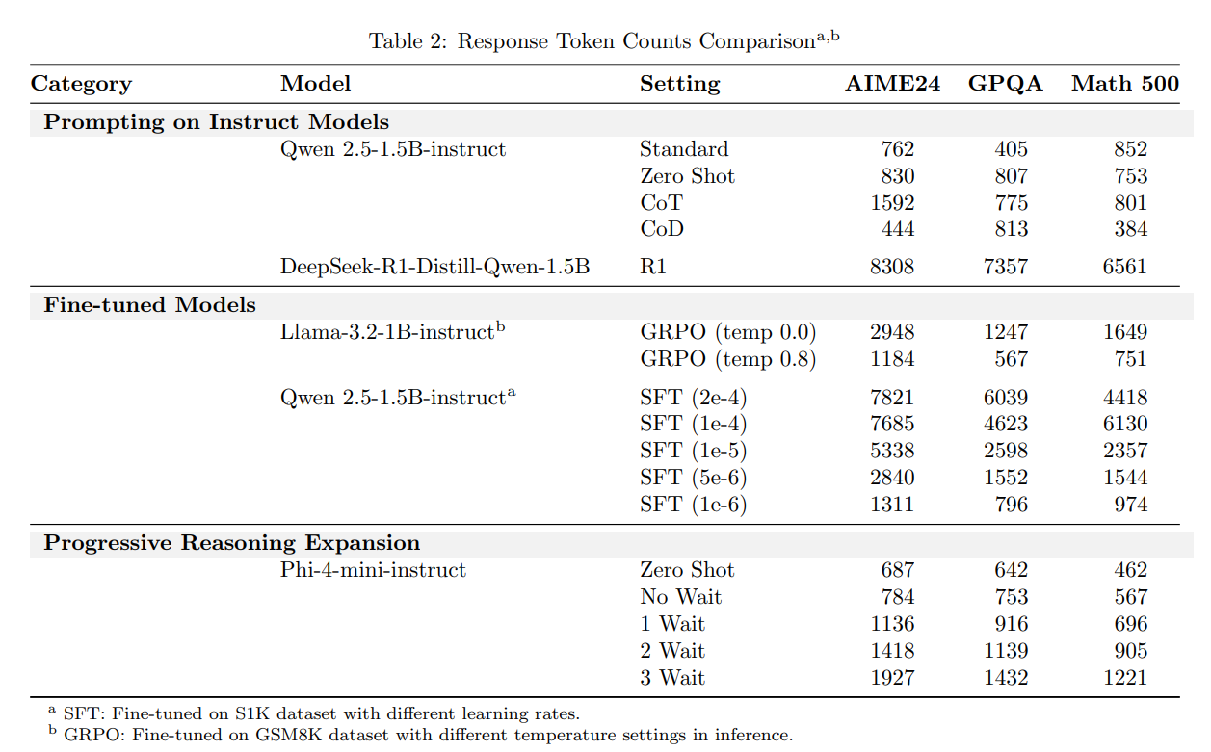
Model Average Response Token Count

Slide 18
Making our own Reasoning Model using SFT

Slide 19
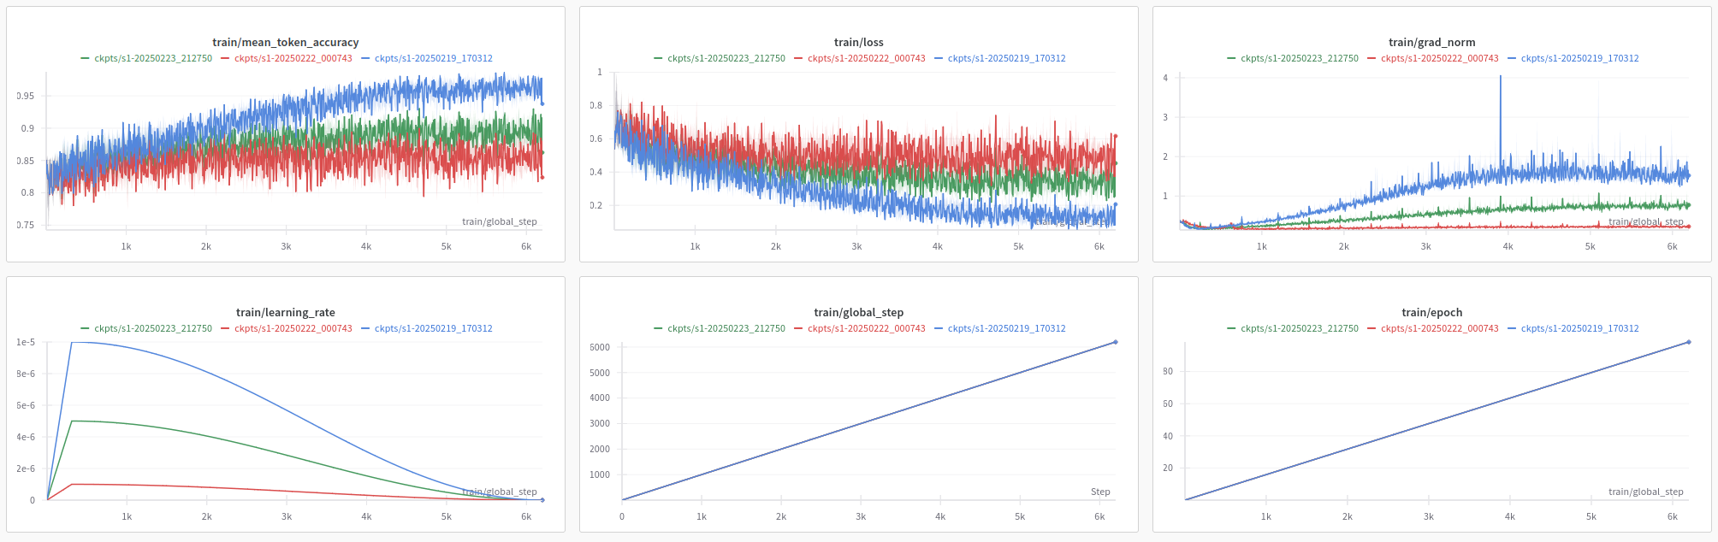
Fine tuning Qwen 2.5-1.5B-instruct using SFT on S1K Dataset

Slide 20
SFT Experiment
I used same hyper parameters as used in S1 Paper but with 4 Bit Quantization and Lora Adapters.
And Model in the paper : Qwen-2.5-32B-instruct
Model we used : Qwen-2.5-1.5B-instruct

Slide 21
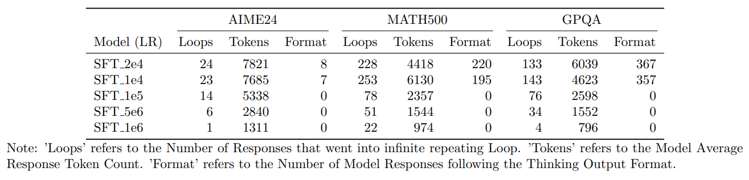
Number of Model Responses that either Got into Infinite loop or followed the Reasoning Format
Model Finetuned : Qwen-2.5-1.5B-instruct

Slide 22
Model Performance

Slide 23
Model Average Response Token Count

Slide 24
Why Qwen was performing that way?
Why it is not following the System Prompt properly?
Why despite of fine tuning, it is a little rigid towards it default answer generation pattern?

Slide 25
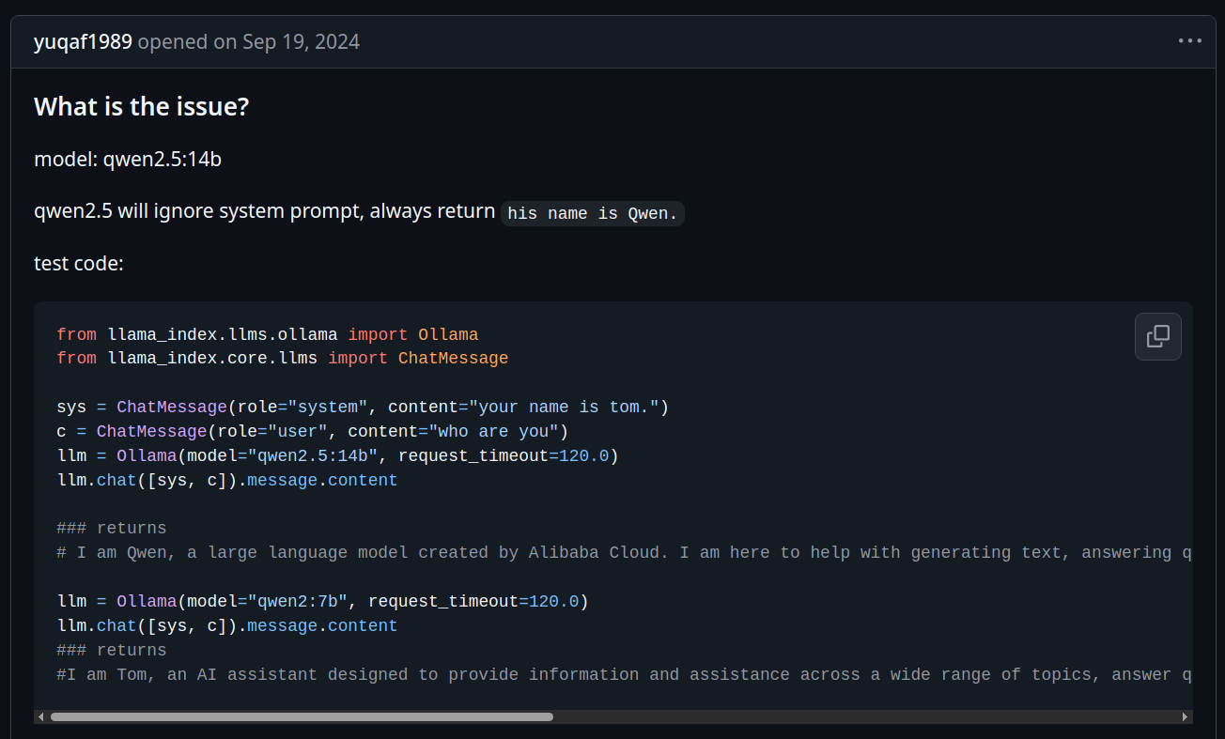
Evidences

Slide 26
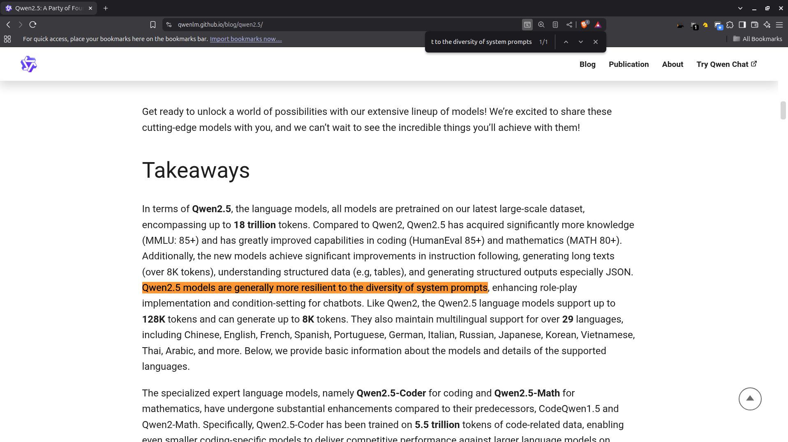
Evidences

Slide 27
Making our own Reasoning Model using GRPO

Slide 28
GRPO
Benefit, you don’t need COT Reasoning in the labels, just input and output.
The model will itself generate multiple solutions and the reward functions will give reward based on its generations.
And the training proceeds, the model aligns with the rewards functions.

Slide 29
GRPO
Two ways to use GRPO:
Train the model to follow the <think> Reasoning </think> format by first applying SFT, ensuring it learns to respond in the desired thinking format. Then, apply GRPO.
Use a system prompt template that specifies the required thinking format for the output.

Slide 30
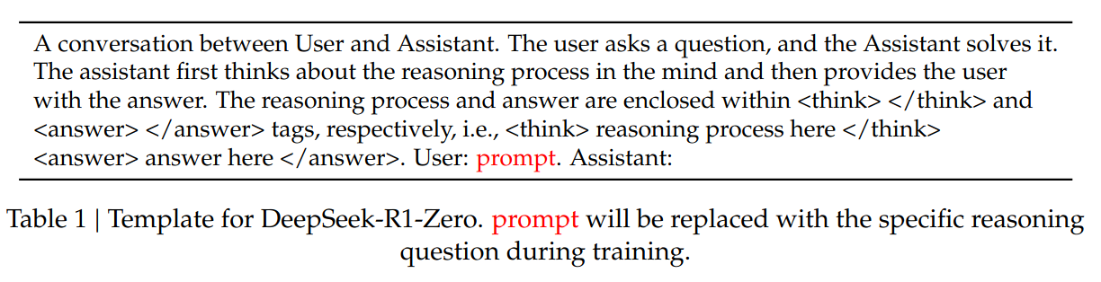
GRPO
Source : Deepseek R1 Paper

Slide 31
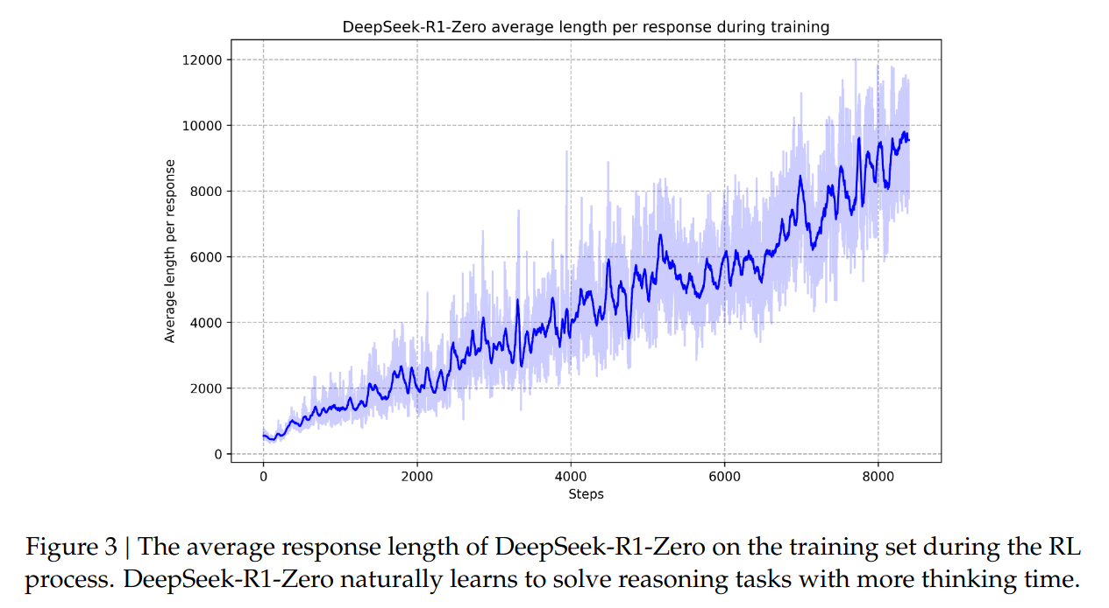
GRPO
Source : Deepseek R1 Paper

Slide 32
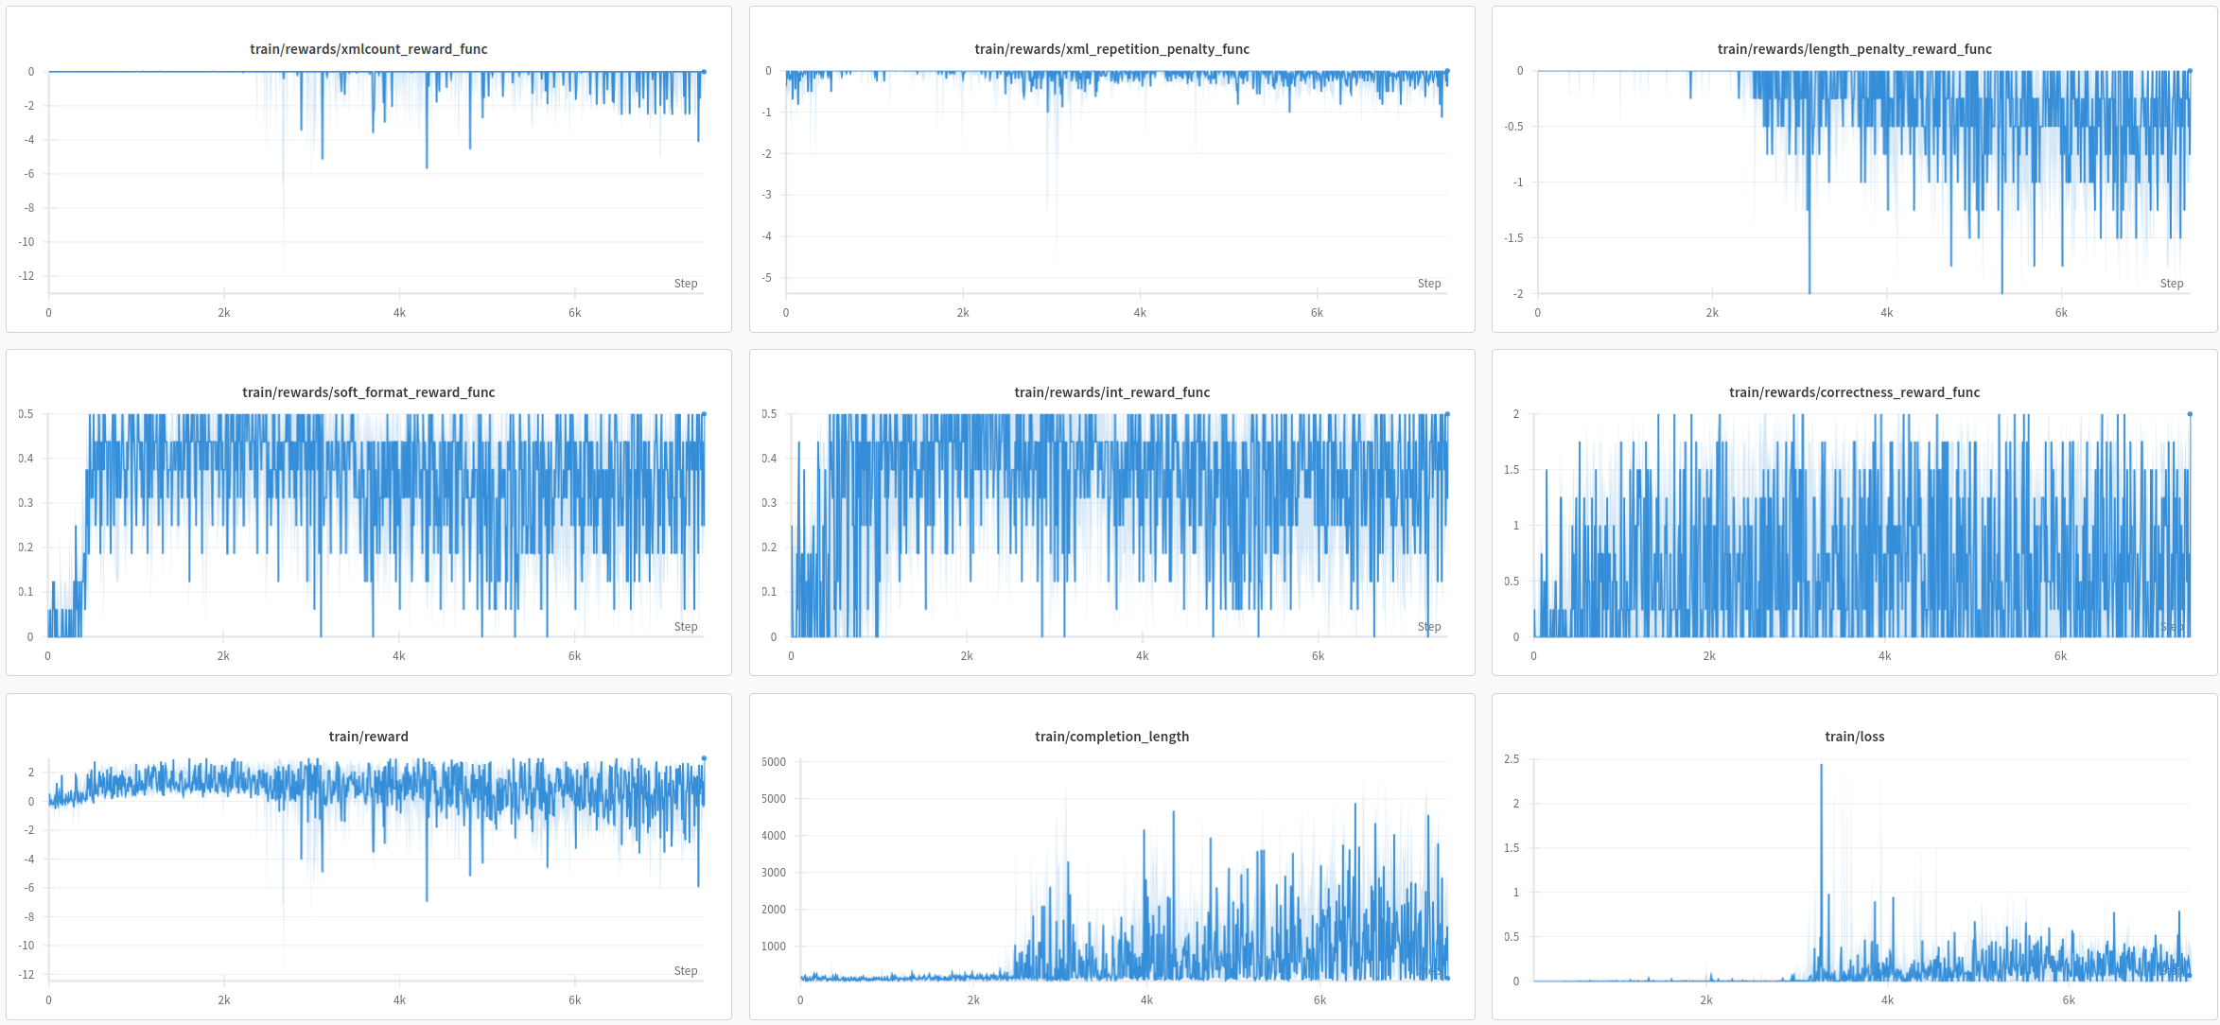
Fine tuning Llama 3.2-1B-instruct using GRPO on GSM8K Dataset

Slide 33
Reward Functions Used
We used the following reward functions :
Penalizing Rewards
XMLCount
XML Repetition Penalty
Length Penalty
Positive Rewards
Soft Format Reward
Int Reward
Correctness Reward

Slide 34
Model Performance

Slide 35
Model Average Response Token Count

Slide 36
Limitation Found: Budget Forcing on Small Models (Llama-3.2-1B)
Forcing the 1B model to "think longer" by appending "Wait" resulted in unstable, gibberish output almost immediately (1-2 iterations).
Suggests smaller models may lack the robustness needed for techniques that significantly alter the generation flow at test time.

Slide 37
Progressive Reasoning Expansion

Slide 38
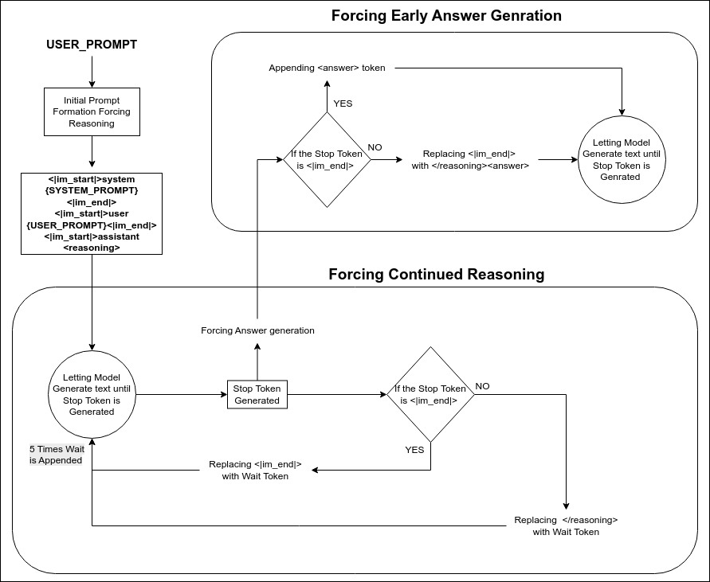
Progressive Reasoning Expansion
To better control test-time reasoning, I propose Progressive Reasoning Expansion. Instead of letting the model generate freely until <|im_end|> (as in Budget Forcing), we force the first token to be <reasoning> and set the stop token as either <|im_end|> or </reasoning>. If generation ends with <|im_end|>, we replace it with </reasoning><answer> to force answer generation and also with Wait to encourage more reasoning. If it ends with </reasoning>, we append <answer> and again use Wait in parallel. This ensures consistent adherence to a reasoning-first generation format.

Slide 39
Model Performance

Slide 40
Model Average Response Token Count

Slide 41
Takeaways
Format Adherence: Small LMs (1–2 B parameters) often fail to stick to required output formats, derailing test‑time optimizations like budget forcing.
Model Traits: Core behaviors of the base model (e.g., Qwen‑2.5 ignoring system prompts) can block prompt‑based methods such as GRPO.
SFT Benefits: Supervised fine‑tuning can embed desired reasoning structures.
SFT Risks: Without careful tuning, SFT on small LMs induces loops, verbosity, and instability despite format gains. Also Low learning rates don’t teach <think> formats

Slide 42
Takeaways (Continued)
GRPO Complexity: Reward‑based policy optimization demands precise reward design and is prone to instability or reward hacking in low‑capacity models.
Instruction‑Following Strength: Models with better inherent instruction compliance (e.g. Phi‑4) adapt more easily to budget forcing with minimal tuning.
Budget Forcing Depends on Baseline: Encouraging longer chains (e.g. Minimum Budget) can spark self‑correction but hinges on the model’s initial reasoning coherence.

Slide 43
Future Work
Future work should prioritize the development of SLMs with improved inherent instruction following, reasoning capabilities, and training stability.
These advancements would create a stronger foundation for applying test-time optimization techniques.
Additionally, exploring simpler, potentially prompt-based, or more robust methods for controlling computational budget and inducing reflection in SLMs remains an important and promising research direction.

Slide 44
Some Extra Stuff

Slide 45
Evaluation the Runs
LLM as a Judge
I tried the Qwen-2.5-1.5B-Instruct model.
It literally gave a response like:
{
Match: True,
Reasoning: "204 from the answer matches with 240 from the model response."
}

Slide 46
Total GPU Hours Used for Experiments
Used ADA for all the experiments
Total GPU Hours Used: 750+ GPU Hours

Slide 47
Thank you very much!

